Slide 1
FoodieBot An assistant food chatbot
Streamline your food ordering process!
By :
Deepti Agarwal (5)
Srishti Agarwal (27)

Slide 2
TABLE OF CONTENTS
01
02
03
04
05
06
Introduction
Description
Chatbot & Website
Technologies Used
Implementation
Charts & Diagrams

Slide 3
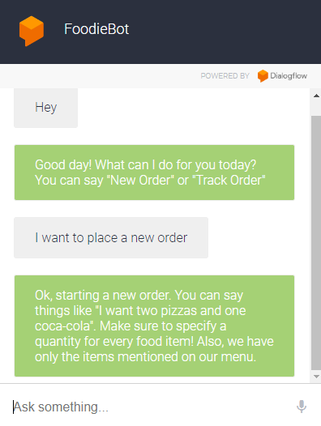
INTRODUCTION
FoodieBot offers a revolutionary approach to food ordering, where users can interact with a chatbot interface in a conversational manner. Imagine ordering food as effortlessly as chatting with a friend. With FoodieBot, that vision becomes a reality. Whether you're craving pizza, burger, or something else, simply chat with FoodieBot to explore menus, place orders, and track delivery status—all in a human-like conversation.

Slide 4
Key features & functionalities
2
4
New
Order
Bill
Calculation
1
3
5
Menu
Browsing
Add/Remove Items
Track
Order

Slide 5
Description
Integrated with FoodieBite website
Natural language understanding
Conversational Chatbot Interface
Integrated with database
Efficiently handles user queries
Convenient and easy to use

Slide 6
FoodieBite Website
FoodieBite website offers a seamless platform for users to explore a variety of culinary delights and conveniently place orders online.

Slide 7
Some snapshots of FoodieBite Website!

Slide 8
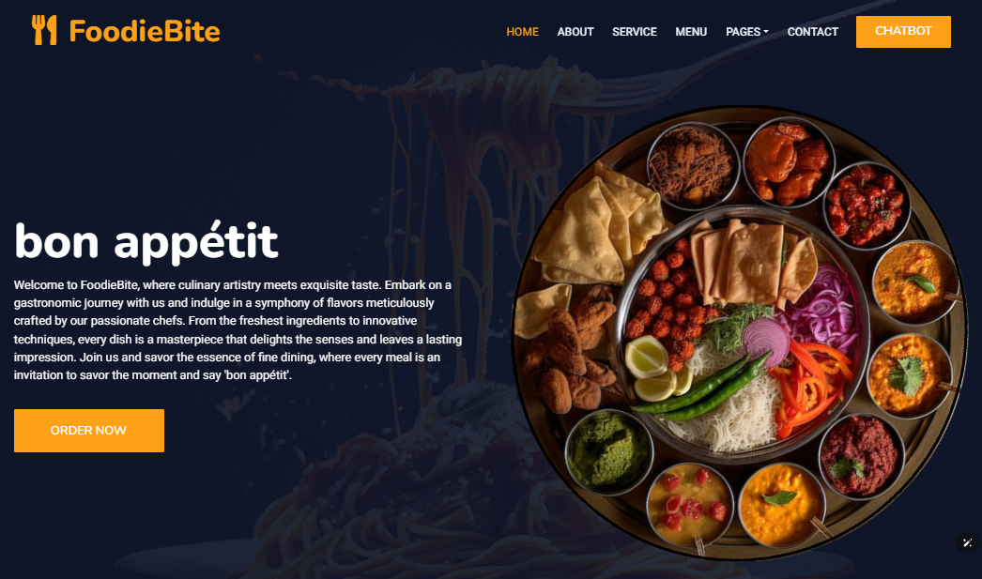
FoodieBite Website

Slide 9
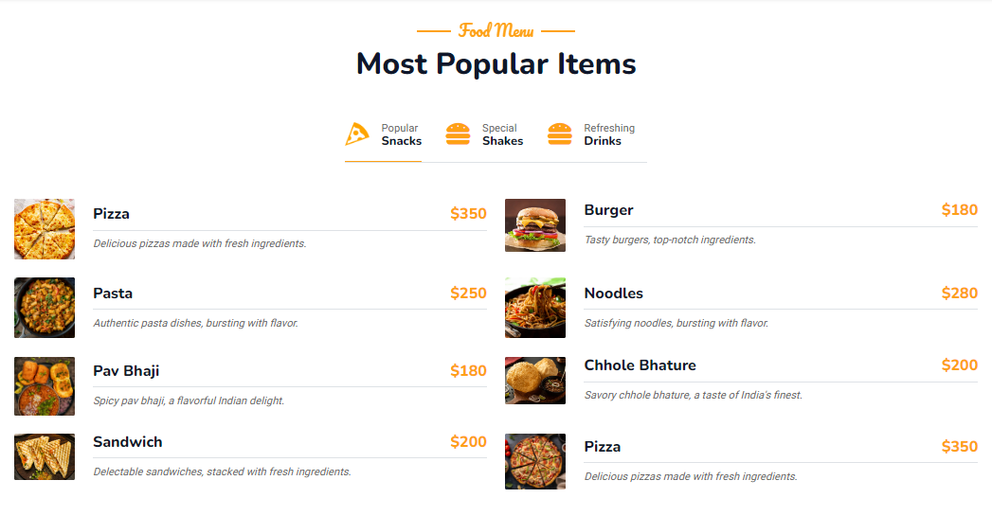
FoodieBite Website

Slide 10
Integration of Chatbot on Website
FoodieBot seamlessly integrates with FoodieBite, to offer users a streamlined and intuitive ordering experience. Through this integration, users can interact with FoodieBot directly on the FoodieBite website, simplifying menu browsing, order placement, and tracking.
The chatbot displays when user clicks on the chatbot button on the top right corner of the FoodieBite website and disappears on clicking again.

Slide 11
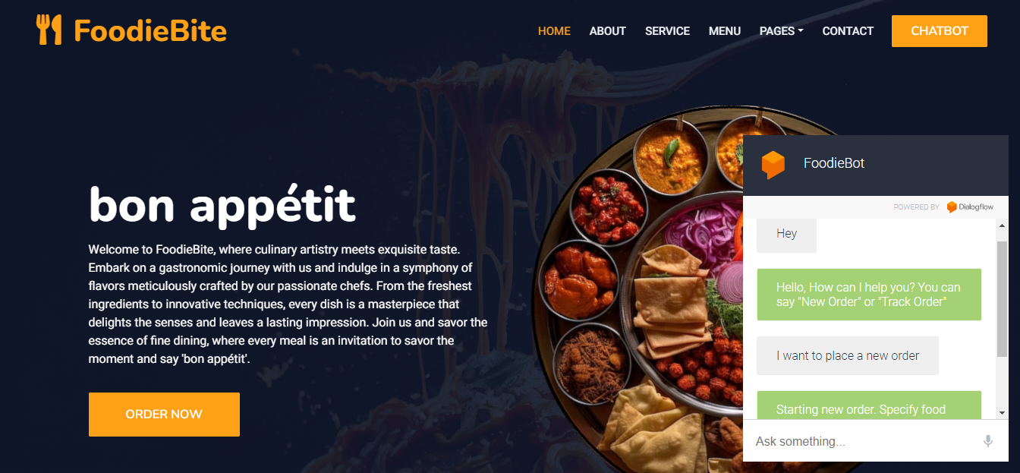
Integration of Chatbot on Website

Slide 12






Technologies Used
Dialogflow
Python
HTML/CSS
MySQL
FastAPI
JavaScript

Slide 13
Implementation
Requirement Analysis : Defining the features and functionalities.
Technology Selection : Selection of suitable tech stack to build the backend logic, chatbot interface, and database infrastructure.
System Design : Designing the system architecture and database schema.
Chatbot Development : Development of FoodieBot using Dialogflow.
Frontend Development : Development of FoodieBite website using HTML, CSS and JavaScript.

Slide 14
Implementation
Backend Development : The backend was implemented using Python and FastAPI to handle user requests, process orders, and communicate with Dialogflow and the database.
Database Implementation : Creation of database and tables and their connection with the backend.
Integration : Connecting backend, frontend, database and chatbot.
Testing : Testing to identify and address any issues or bugs.

Slide 15
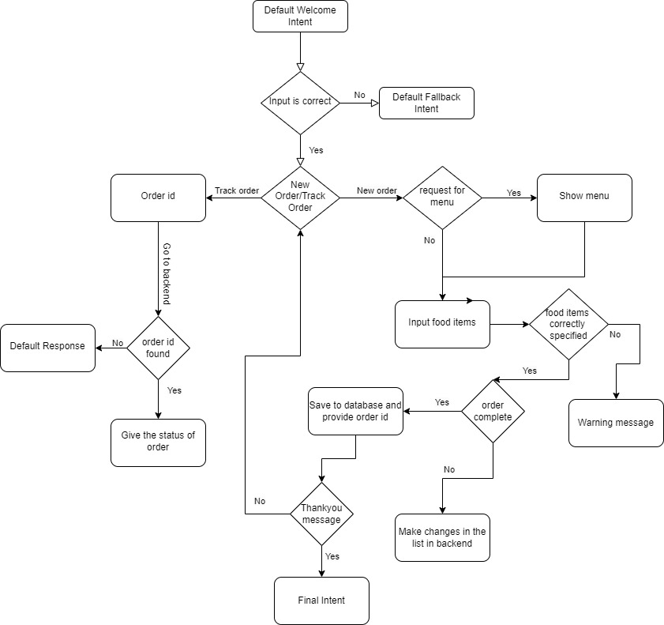
Flowchart

Slide 16
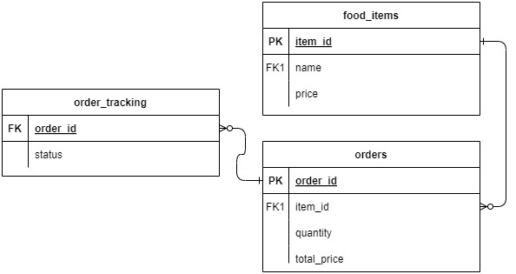
Databse Design

Slide 17
Conclusion
FoodieBot streamlines online food ordering through its intuitive chatbot interface.
Integrated with the FoodieBite website, it simplifies menu browsing, order placement, and tracking.
MySQL for data storage, ensures efficiency, scalability, and reliability in handling user interactions and processing orders.
Offers users a convenient, efficient, and enjoyable way to order their favorite meals with just a few simple interactions.
FoodieBot aims to deliver a superior food ordering experience for users.

Slide 18
THANK YOU!

